Slide 1
Weather Observations

Slide 2


weather observations & measurements
Direct Observations and Measurements
· Basic weather conditions can be observed and/or measured by meteorologists at national weather data collection sites.
· In order to make weather predictions, the data should be collected on a regular basis over a period of time.
· This allows for the development of patterns in weather conditions from the analysis of the data.
· For example, a hurricane’s path can be predicted using data on its position over time (plotted on a hurricane tracking map), thereby allowing meteorologists to make predictions concerning the possible warnings to land areas in the hurricane’s path.
MENU

Slide 3
Recording Daily Weather
 | Day 1 | Day 2 | Day 3 | Day 4 | Day 5
Temperature
Precipitation
Air pressure
Cloud Cover
Wind Direction
Wind Speed

Slide 4
Mean- the average of a set of figures.
Median- the middle value in a set of statistical values.
Mode- a value that has the highest frequency within a set of values.

Slide 5
Recording Daily Weather
 | Mean | Median | Mode
Temperature
Precipitation
Air pressure
Cloud Cover
Wind Direction
Wind Speed

Slide 6

Coordinates for Tropical Storm Hanna
DATE | LATITUDE | LONGITUDE
29-Aug | 21.8 | -63.8
30-Aug | 22.1 | -65.3
31-Aug | 22.9 | -67.8
1-Sep | 23.7 | -72.2
2-Sep | 21.8 | -72.5
3-Sep | 20.5 | -72.4
4-Sep | 23.2 | -72.1
5-Sep | 26.5 | -76.3
6-Sep | 32.4 | -79.1
7-Sep | 40.5 | -73.4

Slide 7
Coordinates for Hurricane Ike
DATE | LATITUDE | LONGITUDE
1-Sep | 18 | -41
2-Sep | 18 | -42
3-Sep | 22 | -53
4-Sep | 22 | -53
5-Sep | 23 | -64
6-Sep | 23 | -66
7-Sep | 21 | -75

Slide 8

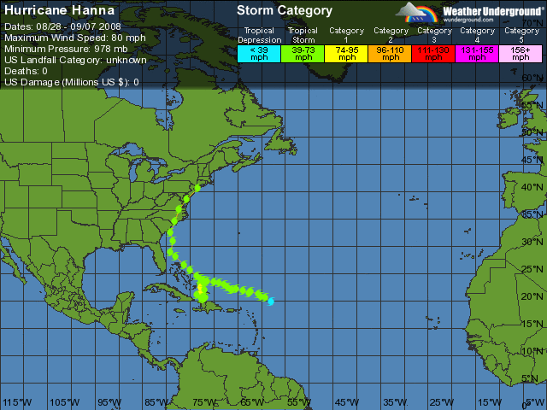
Date | Lat. | Long.
29-Aug | 21.8 | -63.8
30-Aug | 22.1 | -65.3
31-Aug | 22.9 | -67.8
1-Sep | 23.7 | -72.2
2-Sep | 21.8 | -72.5
3-Sep | 20.5 | -72.4
4-Sep | 23.2 | -72.1
5-Sep | 26.5 | -76.3
6-Sep | 32.4 | -79.1
7-Sep | 40.5 | -73.4

Slide 9
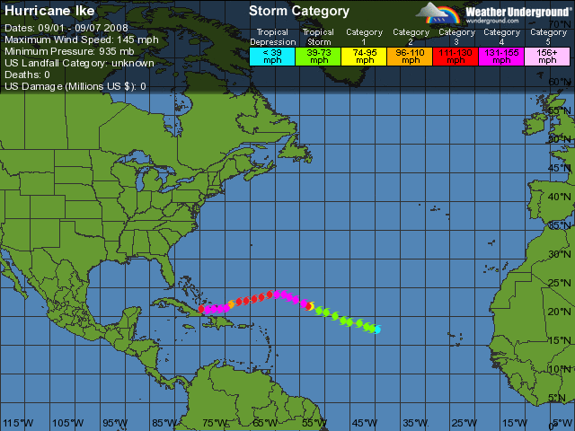
Date | Lat. | Long.
1-Sep | 18 | -41
2-Sep | 18 | -42
3-Sep | 22 | -53
4-Sep | 22 | -53
5-Sep | 23 | -64
6-Sep | 23 | -66
7-Sep | 21 | -75

Slide 10

Temperature
You will usually see temperature measured in °F for maps of the United States
Maps of foreign countries will usually be measured in °C
EdHeads’ Temperature Converter
MENU

Slide 11
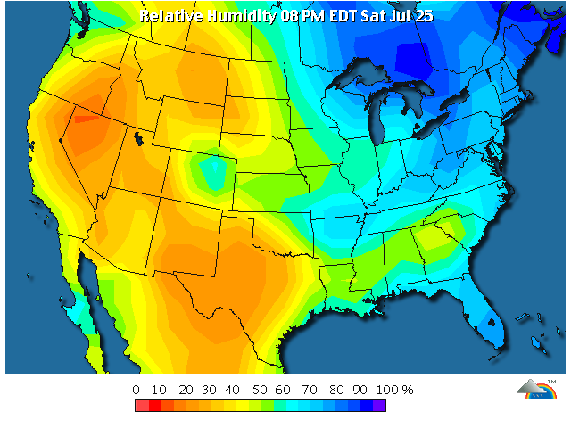
Relative Humidity
The relative humidity tells us how “full” the air is at the time of measurement.
For example, 90% relative humidity means that at that moment the air is holding 90% of the maximum amount of water it could.
MENU

Slide 12
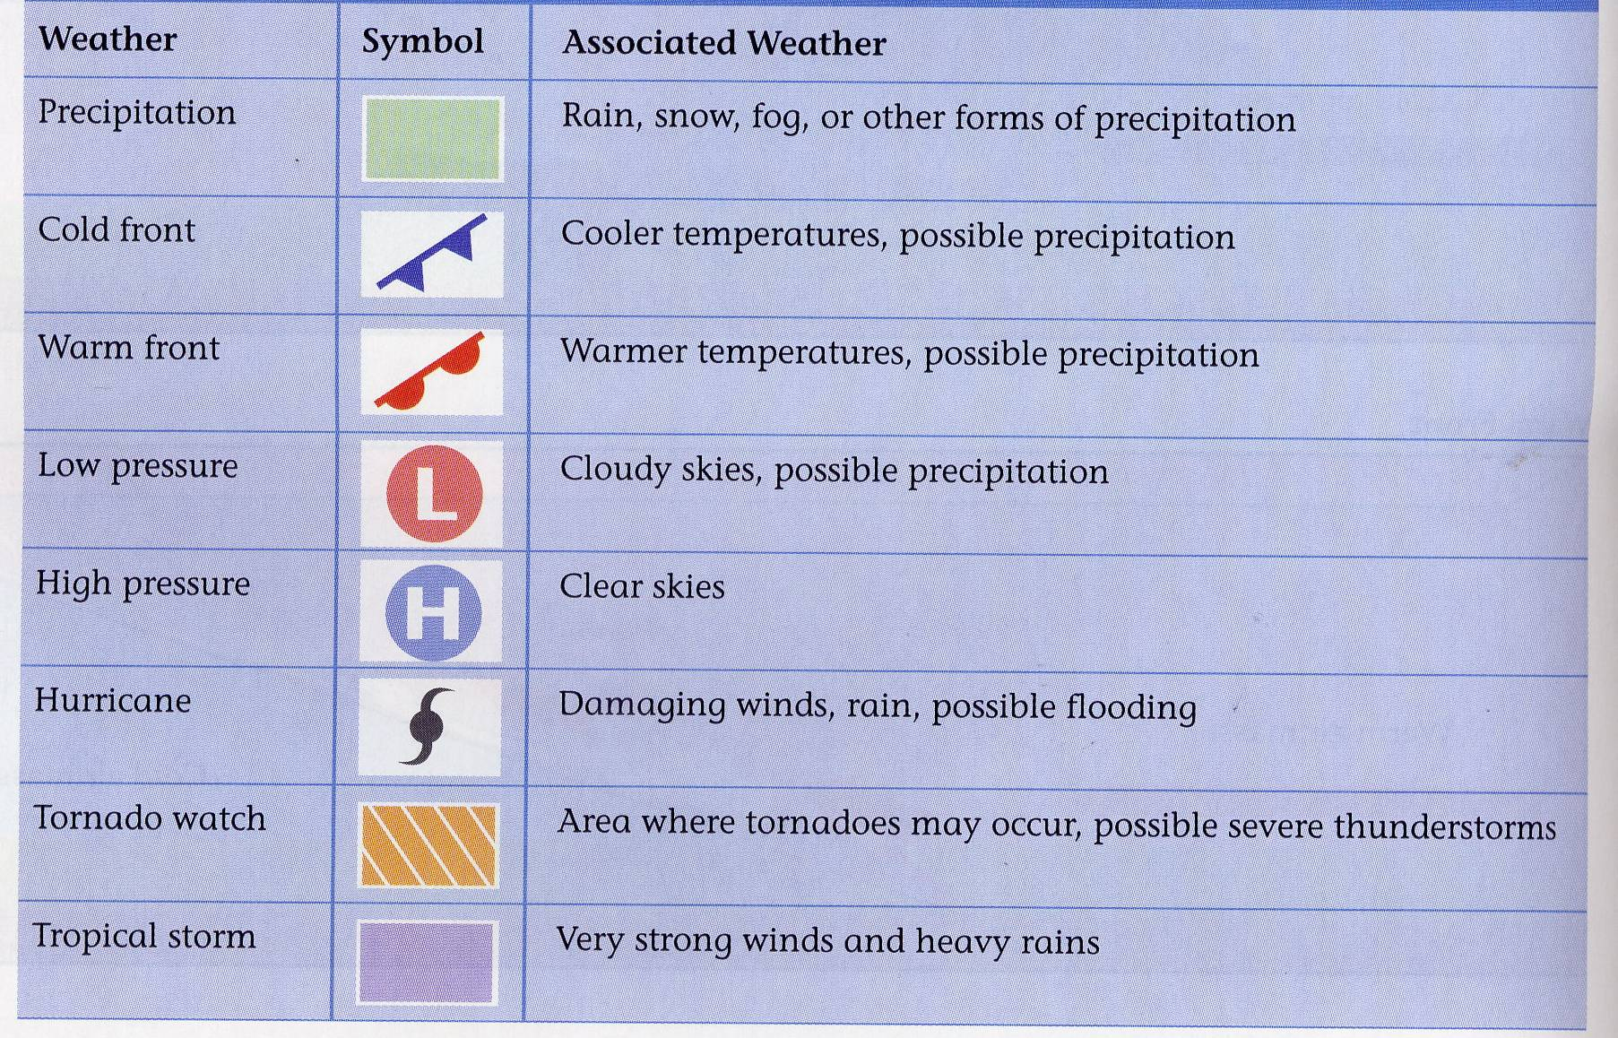
Weather Map Symbols
MENU

Slide 13
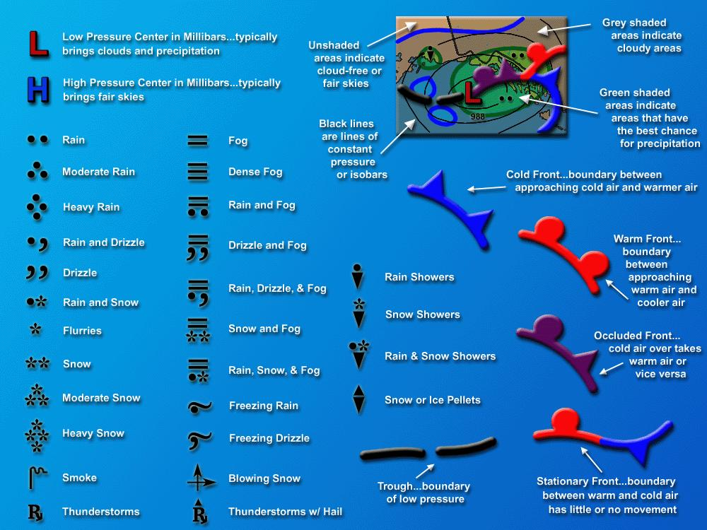
MENU

Slide 14

Station Models
Station models from specific locations provide information that can also be used to predict weather patterns.
Information found on a station model can include cloud cover, temperature (85°F), wind direction and speed, precipitation (snow, rain), or barometric pressure (1002 mb).
MENU

Slide 15
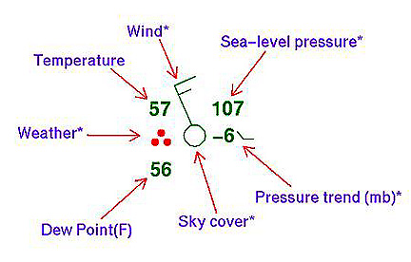

Station Model
MENU

Slide 16
Satellites & Radar
Satellites
· Satellite images are used for seeing cloud patterns and movements.
· For example, hurricane clouds and movement can be observed using satellite images.
Radar
· Radar images can be used to detect cloud cover, rainfall or storm location, intensity, and movement, as well as the potential for severe weather (for example, hurricanes or tornadoes).
MENU

Slide 17
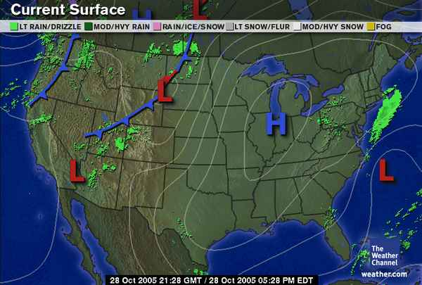
Weather Maps: Doppler Radar Maps
MENU

Slide 18
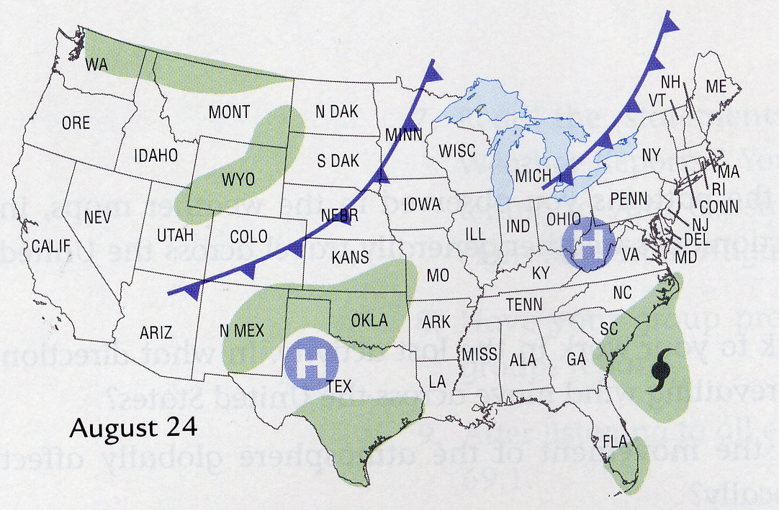

Slide 19
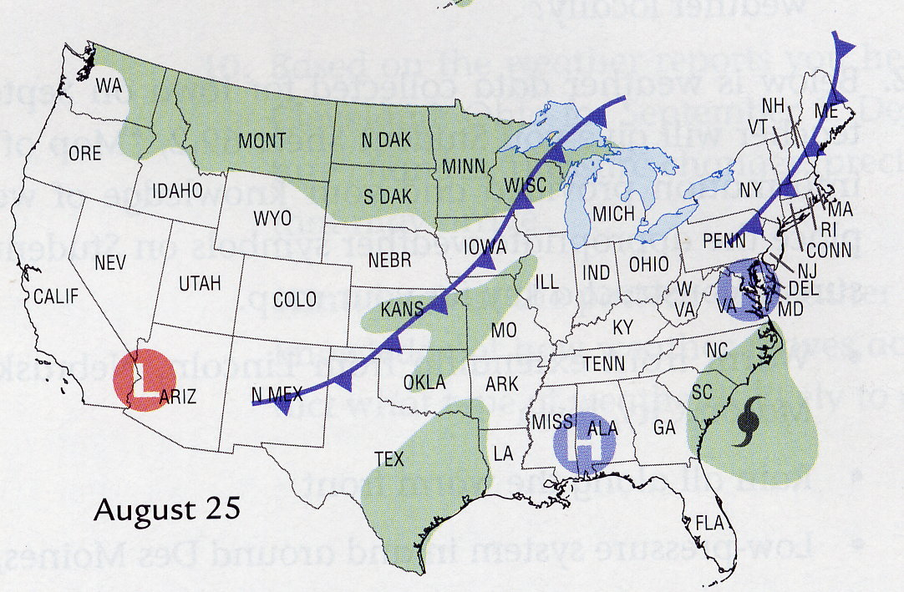

Slide 20
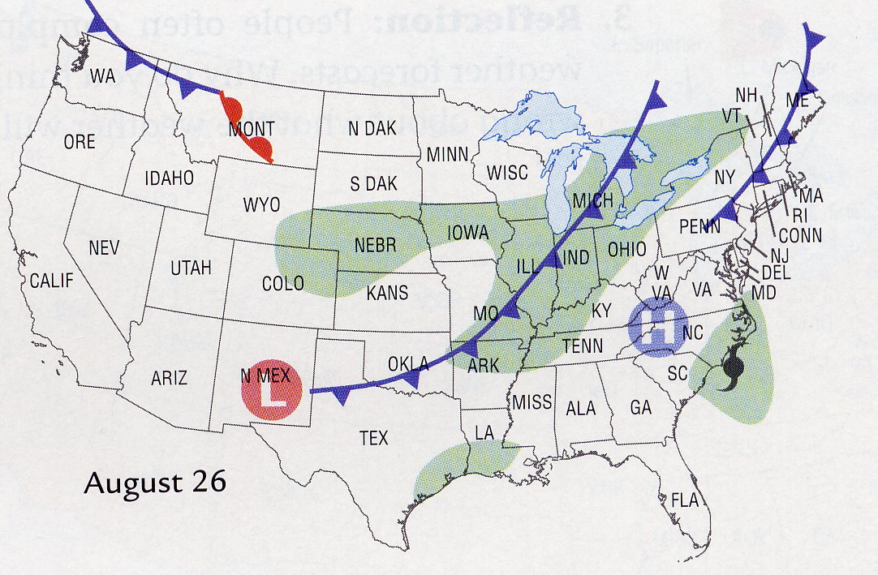

Slide 21
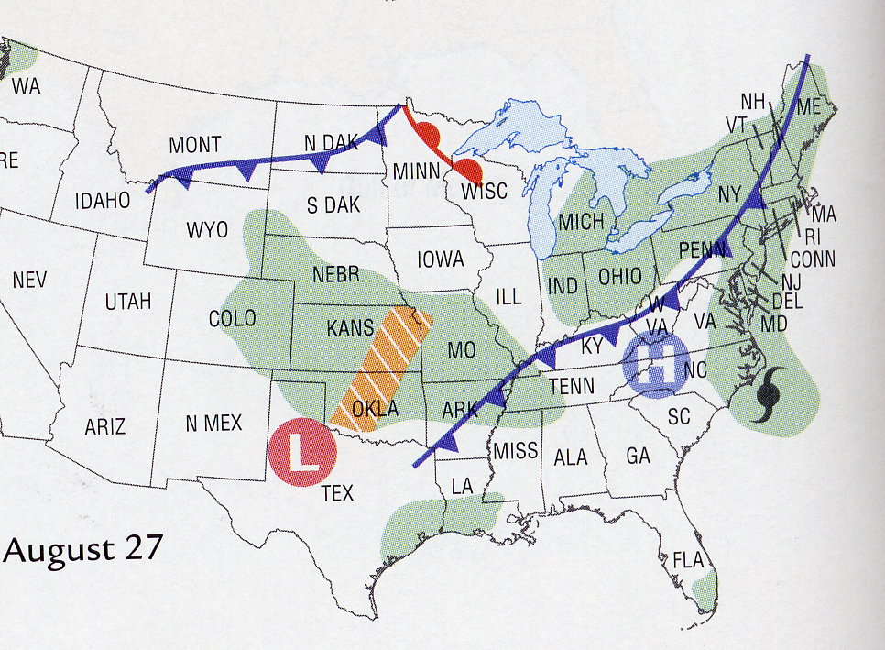

Slide 22
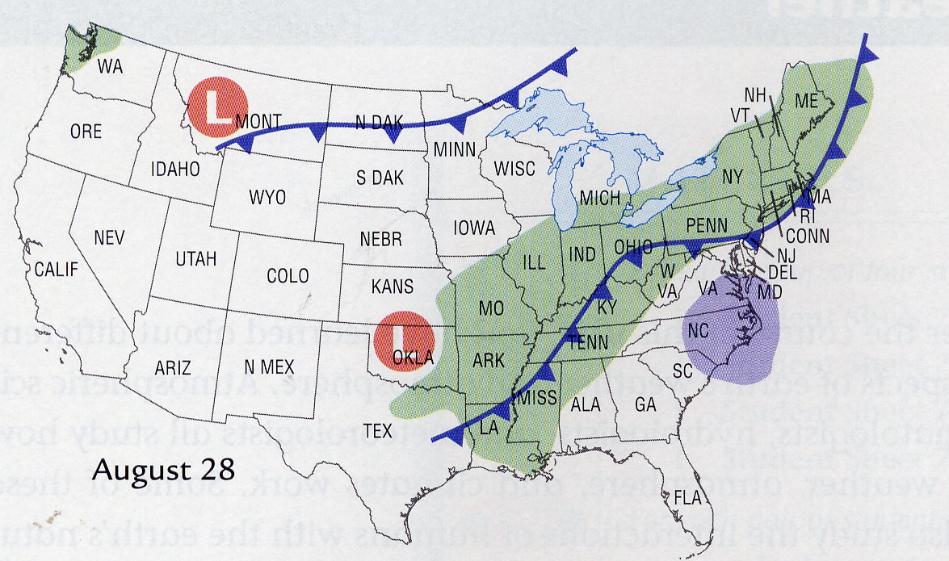

Slide 23
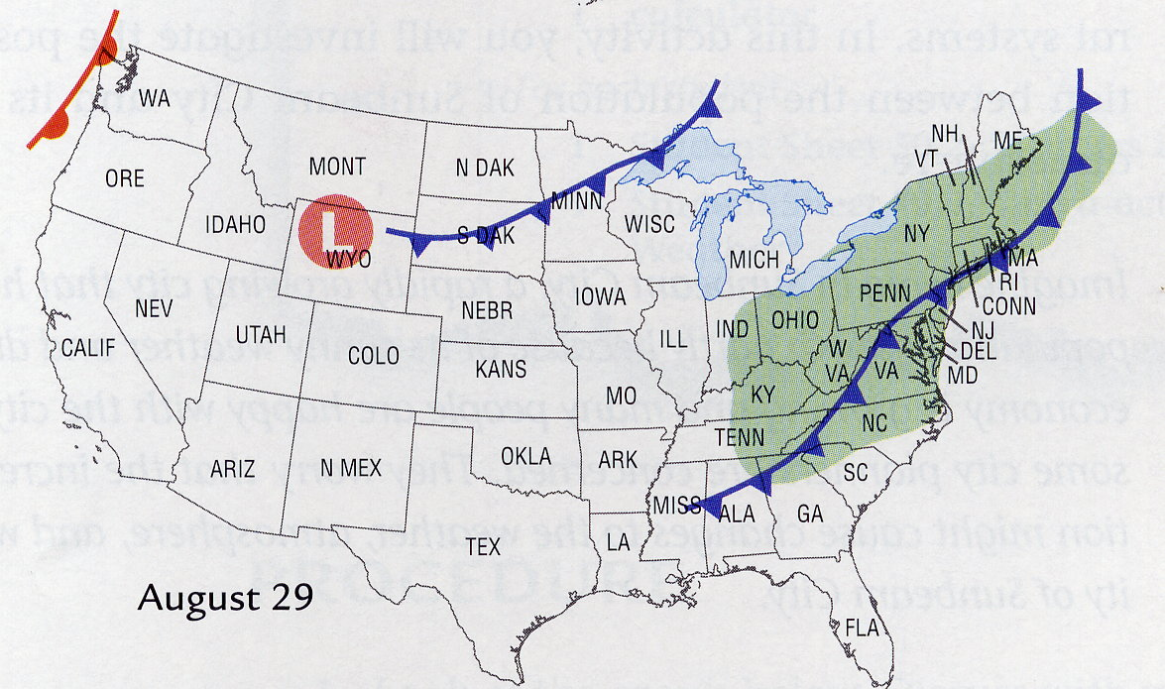

Slide 24
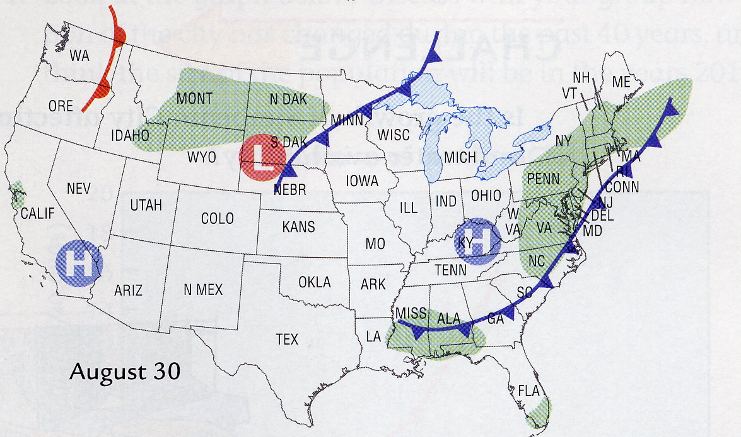

Slide 25
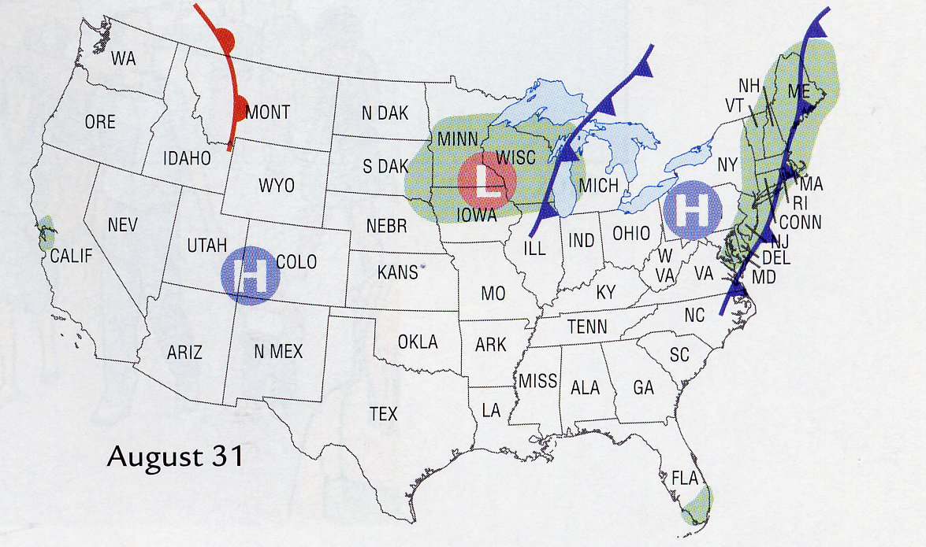

Slide 26

Solar Energy
The driving energy source for heating of Earth and circulation in Earth’s atmosphere comes from the Sun and is known as solar energy.
Some of the Sun’s energy coming through Earth’s atmosphere is reflected or absorbed by gases and/or clouds in the atmosphere.
Sun’s Energy & Earth Video 1:12
Wonders of Weather Video 49:47
MENU

Slide 27
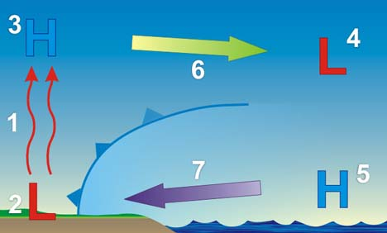
Earth's Land & Water
Land heats up and releases heat quickly, but water needs to absorbs lots of solar energy to warm up
This property of water allows it to warm more slowly but also to release the heat energy more slowly
It is the water on Earth that helps to regulate the temperature range of Earth’s atmosphere.
MENU

Slide 28
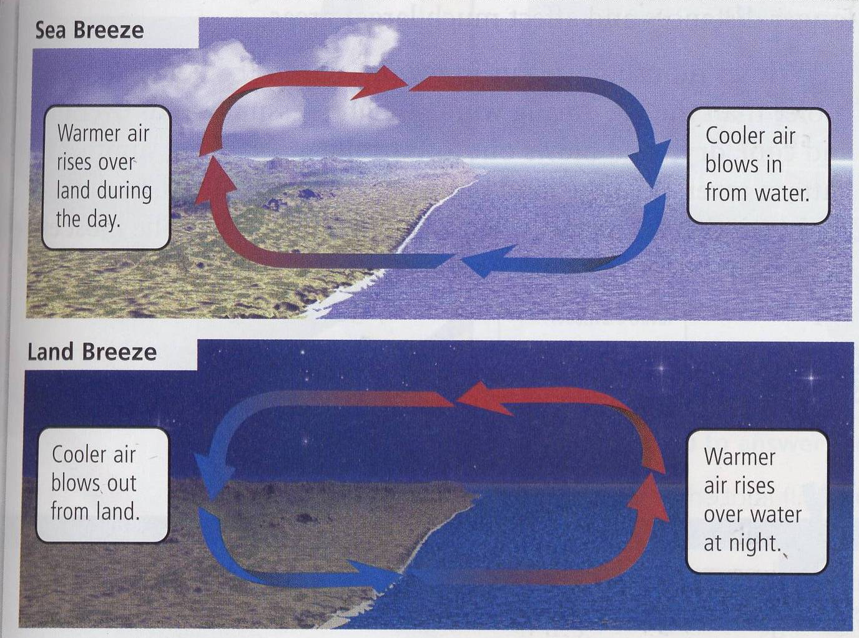
land & sea breezes
On a small scale, convection currents near bodies of water can cause local winds known as land and sea breezes.
MENU

Slide 29
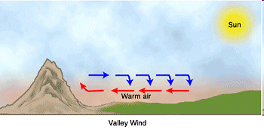
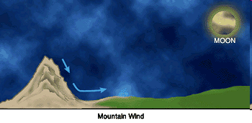
Mountain Winds Katabatic
Winds

Slide 30
Surface currents
The surface currents of Earth’s oceans that circulate warm and cold ocean waters in convection patterns also influence the weather and climates of the landmasses nearby.
The warm Gulf Stream current water influences the eastern Atlantic shoreline of the United States, while the cold California current influences its western Pacific shoreline.
Because of the unequal heating of Earth, climate zones (tropical, temperate, and polar) occur.
MENU

Slide 31
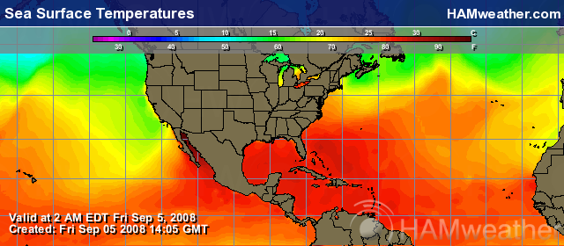
MENU

Slide 32
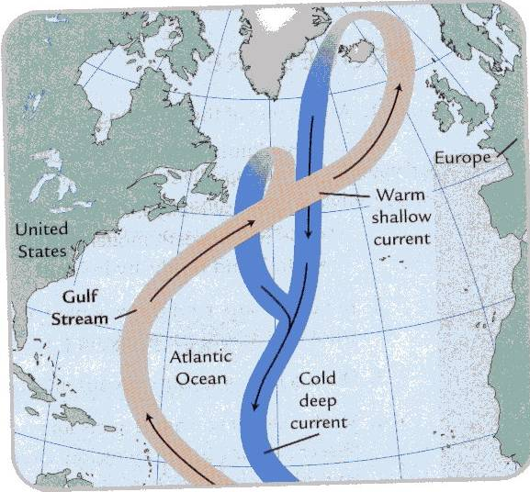
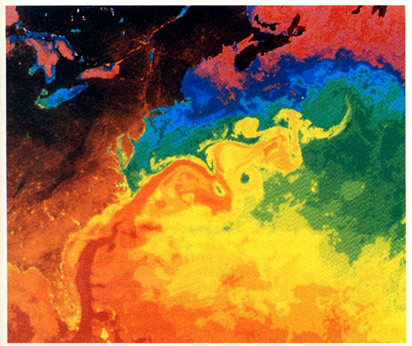
Gulf Stream

Slide 33
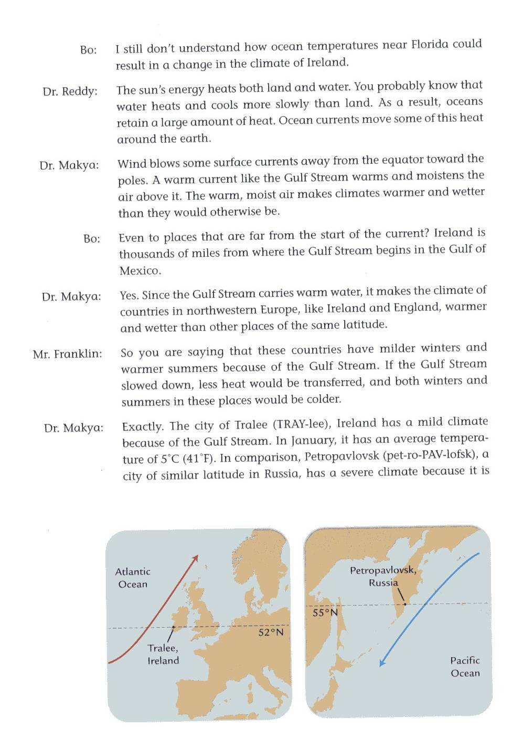

Slide 34
